Slide 1
DIGITAL CASH “Beginning to the end of physical cash”
PROJECT GUIDE :MR.JUSTIN DHAS.Y
SUBMITTED BY :K.S.JAGAN ,C.ROHITH
Maamallan Institute of Technology

Slide 2
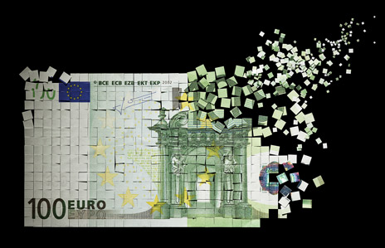
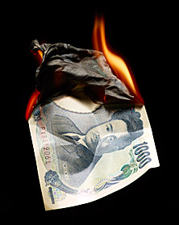
Content
ABSTRACT
EXISTING SYSTEM
PROPOSED SYSTEM
SYSTEM REQUIREMENT
MODULES

Slide 3
ABSTRACT:
Since every thing is digitalizing in out world, money remains as physical entities still.
By digitalizing our physical cash in to digital cash, we can achieve the existing drawbacks of the country and can avoid new problems to be faced.
It reduces the Money orders, banking services, ATM services, Internet/mobile banking services, check facilities, etc.
Makes every transactions by every citizens will be recorded in the centralized and secured data warehouse.
One gadget for every transaction(but now we planed to present our gadget as our own stimulation.)

Slide 4
EXISTING SYSTEM:PHYSICAL CASH
DISADVANTAGE:
No secure( robbery )
More corruption, bribes (No evidence of transaction)
Income tax cheating(by hiding the actual income and expense)
Currency damage, no change cash is available as required.
Requires banking services often in our day today life.
Can spend money for illegal expenses.

Slide 5
PROPOSED SYSTEM:DIGITAL CASH
ADVANTAGE:
Full secure
Avoids corruption
Avoids bribes(since every transactions is recorded)
Automatic Income tax payment
No currency damage or wastage or black money sleeping
Reduces the banking services almost
Easy transactions

Slide 6
SYSTEM REQUIREMENTS:
SOFTWARE REQUIREMENTS:
Operating System : Windows XP2/7
Front End : Apache Tomcat 7
Language : Java
Back End : Oracle
HARDWARE REQUIREMENTS:
Ram : 2GB
Processor : Dual Core / Pentium
Hard Disk : Min 160 GB
Monitor : Min 15 Inch

Slide 7
MODULES:
Registration form using pan account
Shipping of digital cash gadget
Login Form
Physical to digital cash conversion
Account integration(integrates all bank accounts of user)
Normal transactions
Record maintaining

